Slide 1
Lab 7 – Singular Value Decomposition
CS 506

Slide 2
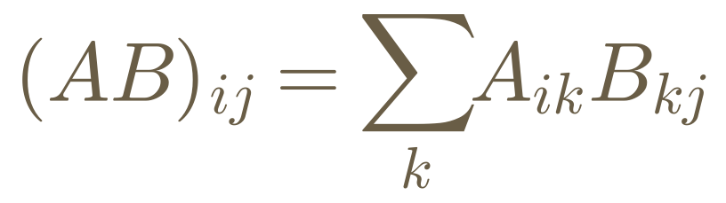
Quick Review: Matrix Multiplication
A is n × m and B is m × p → the product AB is n × p (the inner dimensions must match)
Each entry of AB is the dot product of a row of A and a column of B

Slide 3
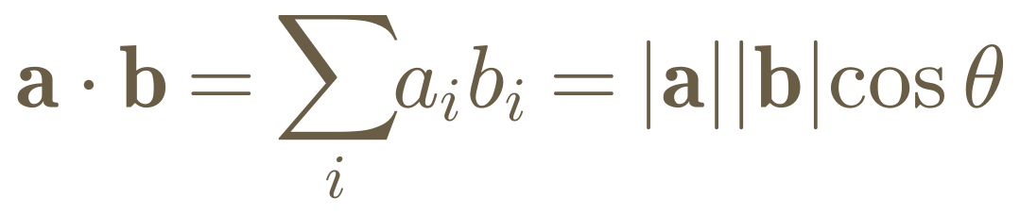
Quick Review: Dot Product
Algebraically: multiply matching entries and add them up — the result is a single number (a scalar)
Geometrically: it measures how much two vectors point in the same direction
Rearranging gives cos θ = (a ⋅ b) / (|a||b|) — the formula behind the cosine similarity we’ll use to compare documents

Slide 4
Feature Extraction
Uncovering relevant features for the task at hand
Typically desire high variance, low correlation data

Slide 5

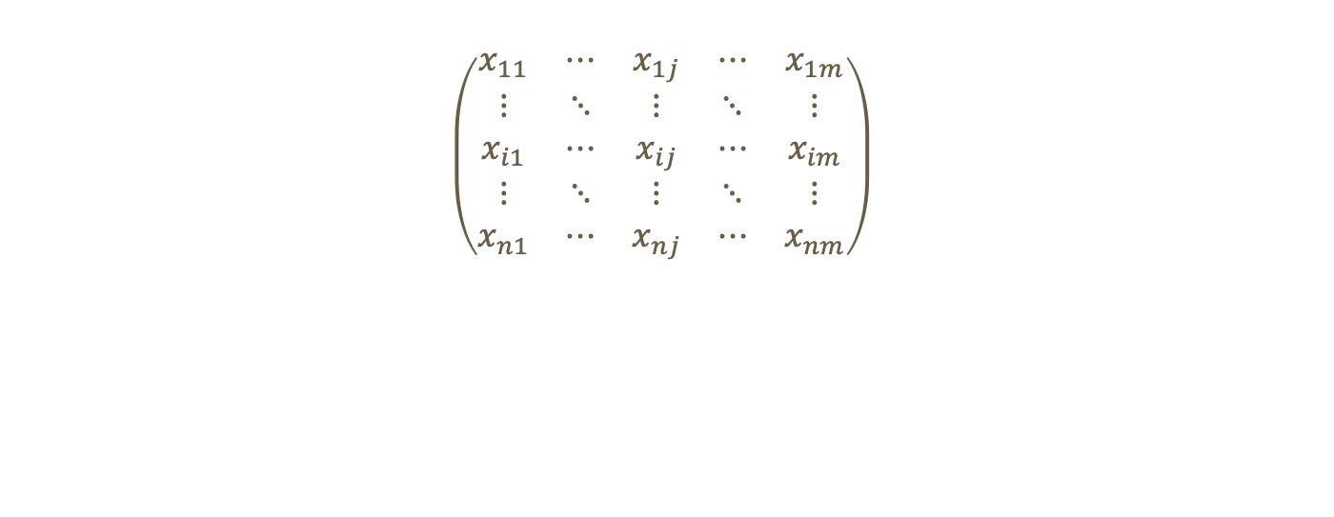

Structure of dataset
$$\left(\begin{matrix}x_{11} & ⋯ & x_{1j} & ⋯ & x_{1m} \\ ⋮ & ⋱ & ⋮ & ⋱ & ⋮ \\ x_{i1} & ⋯ & x_{ij} & ⋯ & x_{im} \\ ⋮ & ⋱ & ⋮ & ⋱ & ⋮ \\ x_{n1} & ⋯ & x_{nj} & ⋯ & x_{nm}\end{matrix}\right)$$
$n$ data points
$m$ features

Slide 6
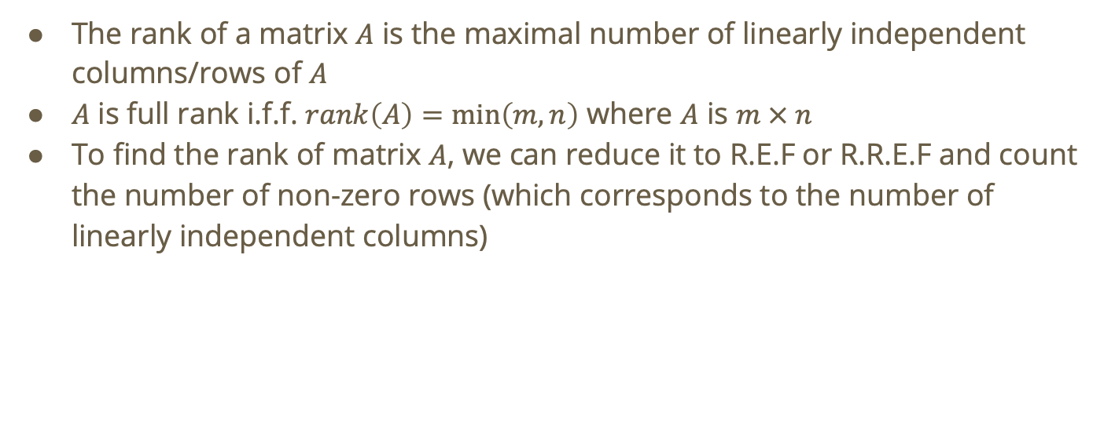
Recall: Rank
The rank of a matrix $A$ is the maximal number of linearly independent columns/rows of $A$
$A$ is full rank i.f.f. $rank\left(A\right)=\min\left(m,n\right)$ where $A$ is $m × n$
To find the rank of matrix $A$, we can reduce it to R.E.F or R.R.E.F and count the number of non-zero rows (which corresponds to the number of linearly independent columns)

Slide 7
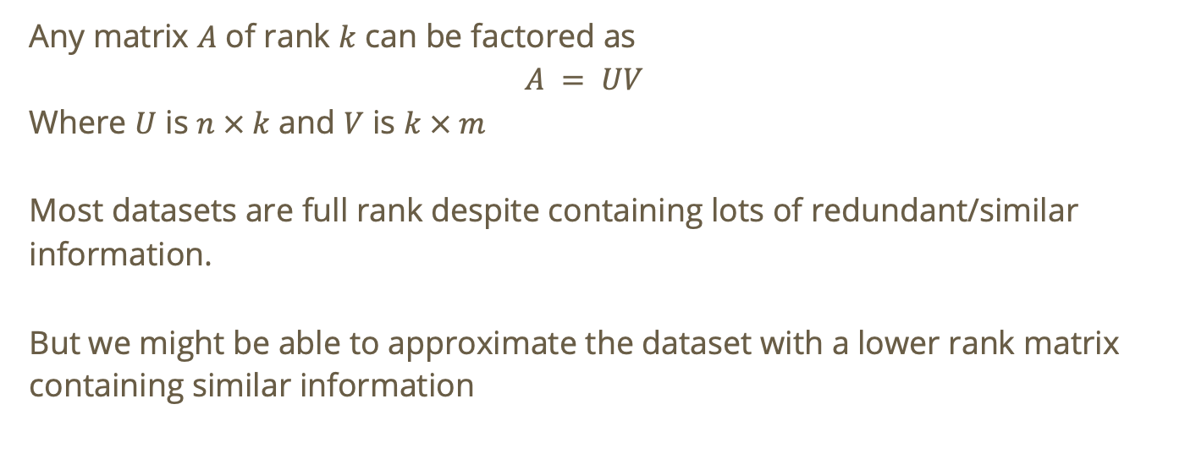
Recall: Matrix Factorization
Any matrix $A$ of rank $k$ can be factored as
$$A = UV$$
Where $U$ is $n × k$ and $V$ is $k × m$
Most datasets are full rank despite containing lots of redundant/similar information.
But we might be able to approximate the dataset with a lower rank matrix containing similar information

Slide 8
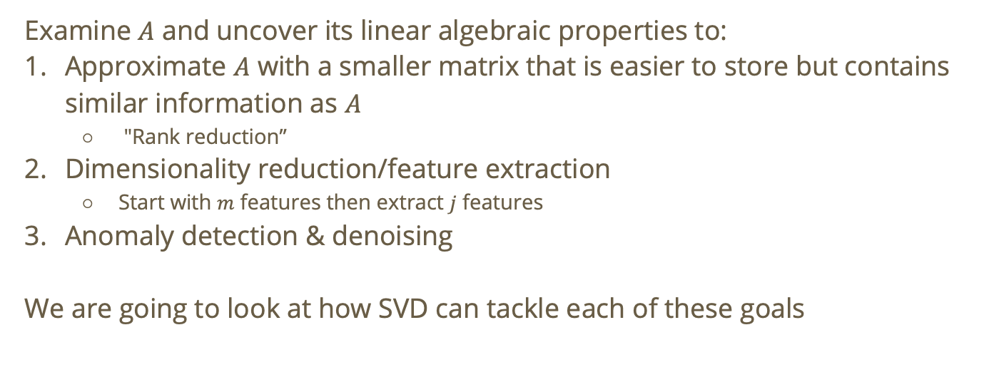
Goal
Examine $A$ and uncover its linear algebraic properties to:
Approximate $A$ with a smaller matrix that is easier to store but contains similar information as $A$
  "Rank reduction”
Dimensionality reduction/feature extraction
  Start with $m$ features then extract $j$ features
Anomaly detection & denoising
We are going to look at how SVD can tackle each of these goals

Slide 9
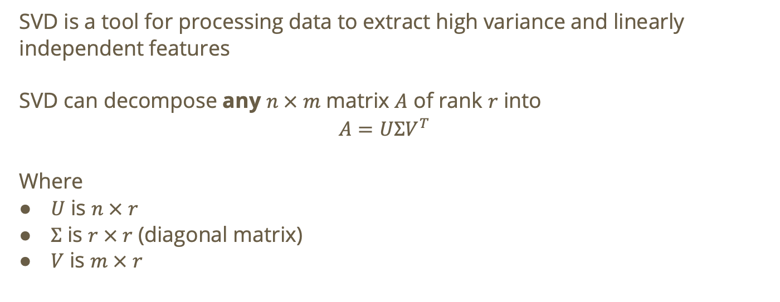
Singular Value Decomposition (SVD)
SVD is a tool for processing data to extract high variance and linearly independent features
SVD can decompose any $n × m$ matrix $A$ of rank $r$ into
$$A=UΣV^{T}$$
Where
$U$ is $n × r$
$Σ$ is $r × r$ (diagonal matrix)
$V$ is $m × r$

Slide 10
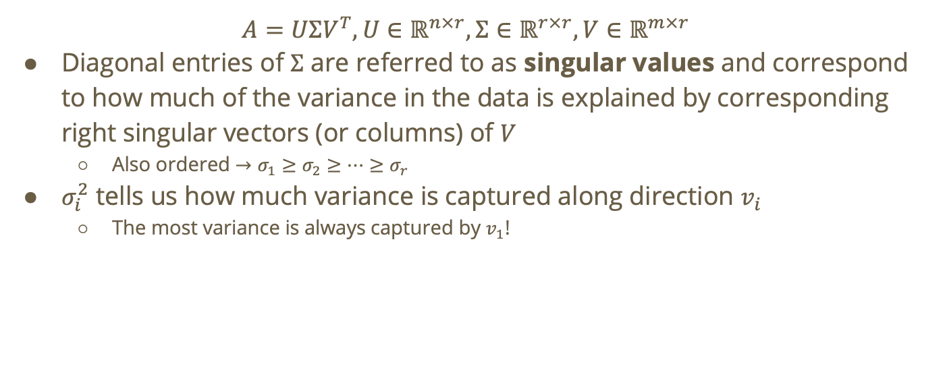
SVD Matrix Decomposition
$$A=UΣV^{T},U∈ℝ^{n×r},Σ∈ℝ^{r×r},V∈ℝ^{m×r}$$
Diagonal entries of $Σ$ are referred to as singular values and correspond to how much of the variance in the data is explained by corresponding right singular vectors (or columns) of $V$
  Also ordered $→σ_{1}≥σ_{2}≥⋯≥σ_{r}$
$σ_{i}^{2}$ tells us how much variance is captured along direction $v_{i}$
  The most variance is always captured by $v_{1}$!

Slide 11
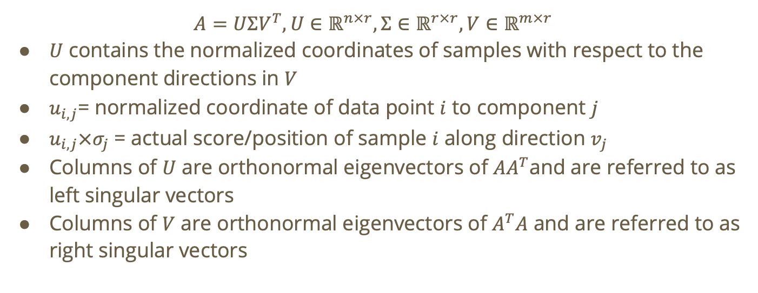
SVD Matrix Decomposition
$$A=UΣV^{T},U∈ℝ^{n×r},Σ∈ℝ^{r×r},V∈ℝ^{m×r}$$
$U$ contains the normalized coordinates of samples with respect to the component directions in $V$
$u_{i,j}$= normalized coordinate of data point $i$ to component $j$
$u_{i,j}×σ_{j}$ = actual score/position of sample $i$ along direction $v_{j}$
Columns of $U$ are orthonormal eigenvectors of $AA^{T}$and are referred to as left singular vectors
Columns of $V$ are orthonormal eigenvectors of $A^{T}A$ and are referred to as right singular vectors

Slide 12
SVD for Rank Reduction

Slide 13
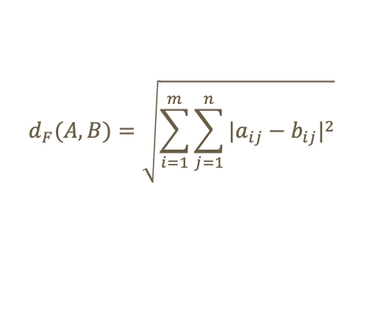
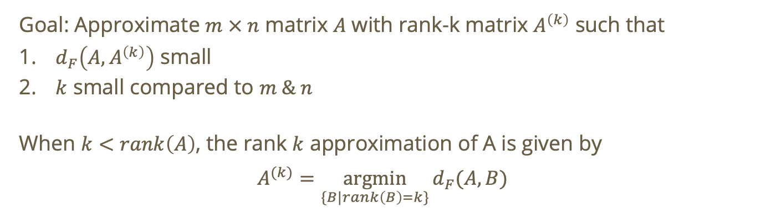
Approximation for A
Goal: Approximate $m × n$ matrix $A$ with rank-k matrix $A^{\left(k\right)}$ such that
$d_{F}\left(A,A^{\left(k\right)}\right)$ small
$k$ small compared to $m \& n$
When $k<rank\left(A\right)$, the rank $k$ approximation of A is given by
$$A^{(k)}=\underset{\{B|rank\left(B\right)=k\}}{argmin}{d_{F}}{(A,B)}$$
$$d_{F}(A,B)=\sqrt{\sum_{i=1}^{m}{\sum_{j=1}^{n}{{|a_{ij}−b_{ij}|}^{2}}}}$$

Slide 14
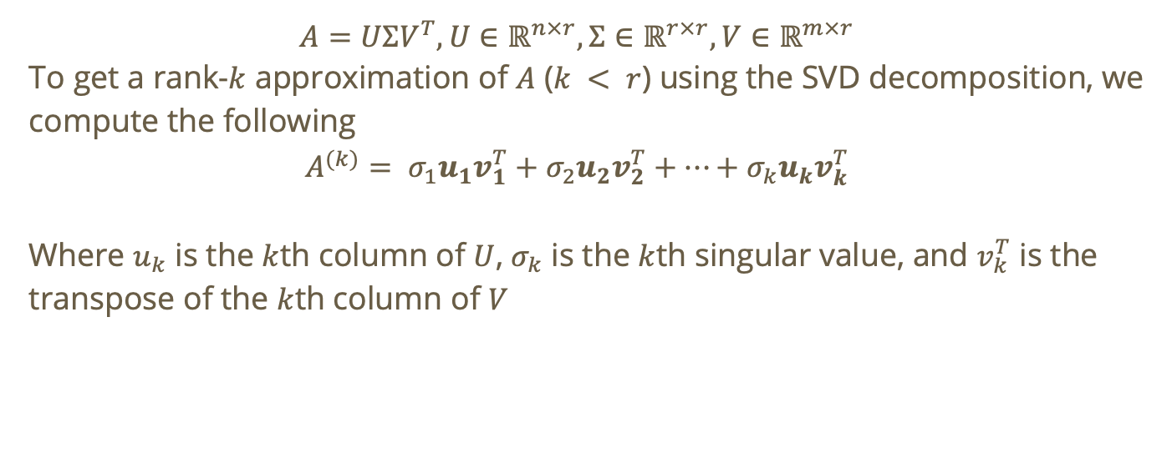
Rank-k approximation using SVD
$$A=UΣV^{T},U∈ℝ^{n×r},Σ∈ℝ^{r×r},V∈ℝ^{m×r}$$
To get a rank-$k$ approximation of $A$ ($k < r$) using the SVD decomposition, we compute the following
$$A^{(k)}= σ_{1}u_{1}v_{1}^{T}+σ_{2}u_{2}v_{2}^{T}+⋯+σ_{k}u_{k}v_{k}^{T}$$
Where $u_{k}$ is the $k$th column of $U$, $σ_{k}$ is the $k$th singular value, and $v_{k}^{T}$ is the transpose of the $k$th column of $V$

Slide 15
Do not edit
How to change the design
In the rank-k approximation A^(k) = σ₁u₁v₁ᵀ + ... + σₖuₖvₖᵀ, what are the dimensions of each term σᵢuᵢvᵢᵀ?
The Slido app must be installed on every computer you’re presenting from

Slide 16
Do not edit
How to change the design
As k increases, the frobenius distance between a matrix and its rank-k approximation decreases
The Slido app must be installed on every computer you’re presenting from

Slide 17
SVD for Feature Extraction

Slide 18
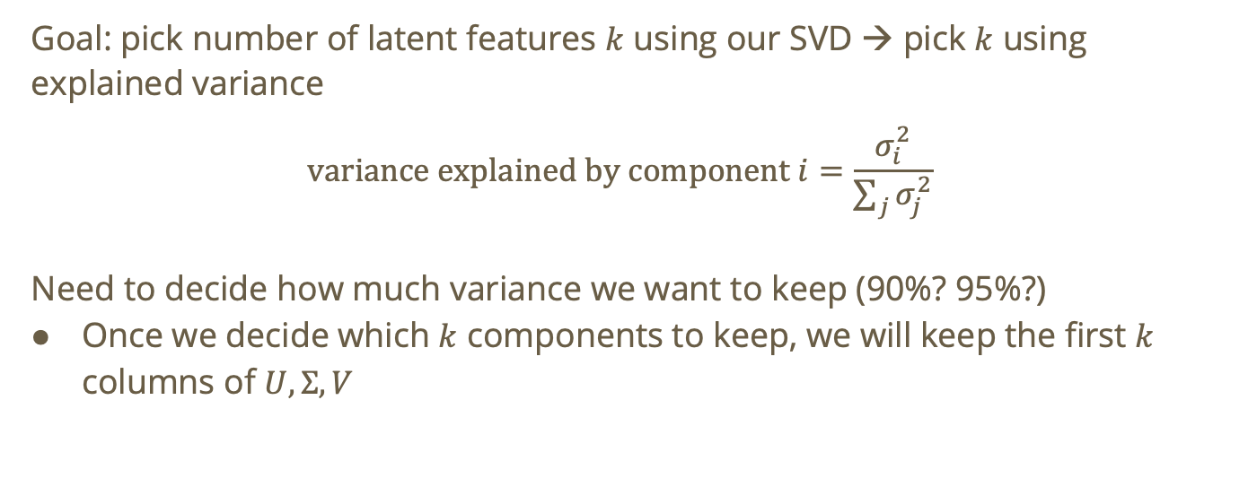
Feature Extraction
Goal: pick number of latent features $k$ using our SVD → pick $k$ using explained variance
$$\text{variance explained by component }i=\frac{σ_{i}^{2}}{\sum_{j}{σ_{j}^{2}}}$$
Need to decide how much variance we want to keep (90%? 95%?)
Once we decide which $k$ components to keep, we will keep the first $k$ columns of $U, Σ, V$

Slide 19
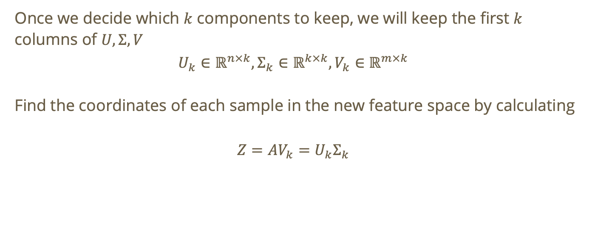
Feature Extraction
Once we decide which $k$ components to keep, we will keep the first $k$ columns of $U, Σ, V$
$$U_{k}∈ℝ^{n×k},Σ_{k}∈ℝ^{k×k},V_{k}∈ℝ^{m×k}$$
Find the coordinates of each sample in the new feature space by calculating
$$Z=AV_{k}=U_{k}Σ_{k}$$

Slide 20
Do not edit
How to change the design
Given an n × m data matrix A (n samples, m original features) with SVD A = UΣVᵀ, you extract features by projecting onto the top-k right singular vectors: Z = A V_k, where V_k is the m × k matrix of the first k columns of V. What are the dimensions of Z, and what do its columns represent?
The Slido app must be installed on every computer you’re presenting from

Slide 21
SVD for Anomaly Detection

Slide 22
What is an anomaly in data science?
Anomaly detection, or outlier detection, is the identification of observations, events, or data points that deviate from what is usual, standard, or expected, making them inconsistent with the rest of the data set¹.
¹IBM - What is Anomaly Detection

Slide 23
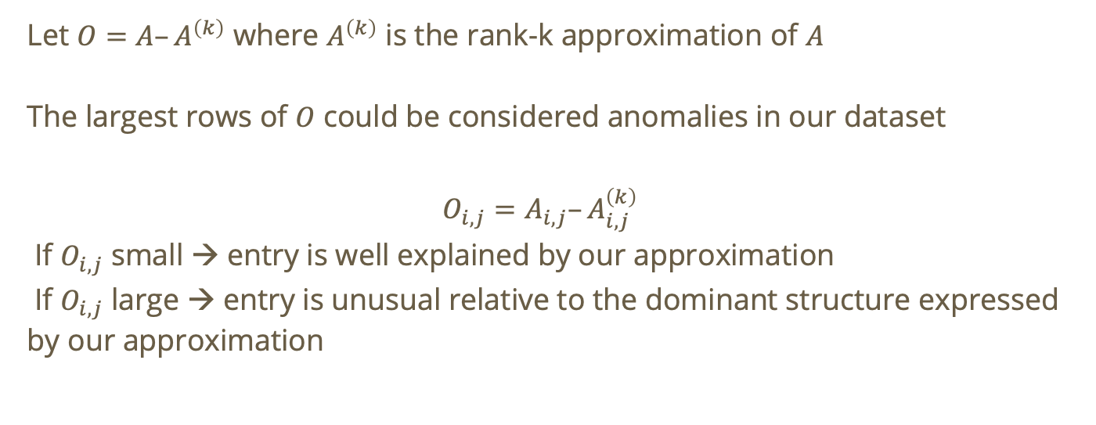
Anomaly Detection in SVD
Let $O=A–A^{\left(k\right)}$ where $A^{\left(k\right)}$ is the rank-k approximation of $A$
The largest rows of $O$ could be considered anomalies in our dataset
$$O_{i,j}=A_{i,j}–A_{i,j}^{\left(k\right)}$$
If $O_{i,j}$ small → entry is well explained by our approximation
If $O_{i,j}$ large → entry is unusual relative to the dominant structure expressed by our approximation

Slide 24
Latent Semantic Analysis (LSA)

Slide 25
Recall: LSA
The goal of LSA is to uncover hidden relationships between words and documents.
  i.e., group together words that are associated with a similar topic
Words that never appear together can end up close in reduced space
LSA is linear, deterministic, fast, and less expensive than using linear models

Slide 26
Recall: Dataset
 | data | information | retrieval | brain | lung
CS-paper-1 | 1 | 1 | 1 | 0 | 0
CS-paper-2 | 2 | 2 | 2 | 0 | 0
CS-paper-3 | 1 | 1 | 1 | 0 | 0
CS-paper-4 | 5 | 5 | 5 | 0 | 0
Med-paper-1 | 0 | 0 | 0 | 2 | 2
Med-paper-2 | 0 | 0 | 0 | 3 | 3
Med-paper-3 | 0 | 0 | 0 | 1 | 1

Slide 27
Recall: Embeddings
The goal of embeddings is to map words (in this case) onto a relatively small dimensional space where similar words are close to one another
The idea is that we take representations of words that we have mapped to a high-dimensional space (using a term-document matrix) and project them into a lower-dimensional space.
We accomplish this using SVD!
Notes:
If needed, show what a one hot representation is

Slide 28



$$U$$
doc-to-concept similarity matrix
0.18 | 0
0.36 | 0
0.18 | 0
0.90 | 0
0 | 0.53
0 | 0.80
0 | 0.27
“strength” of each concept
$$V^{T}$$
$$Σ$$
term-to-concept similarity matrix
9.64 | 0
0 | 5.29
0.58 | 0.58 | 0.58 | 0 | 0
0 | 0 | 0 | 0.71 | 0.71
Notes:
This is an SVD for our dataset. Keep in mind, concepts here refer to latent concepts/hidden concepts

Slide 29
doc-to-concept similarity matrix
0.18 | 0
0.36 | 0
0.18 | 0
0.90 | 0
0 | 0.53
0 | 0.80
0 | 0.27
“strength” of each concept
term-to-concept similarity matrix
9.64 | 0
0 | 5.29
0.58 | 0.58 | 0.58 | 0 | 0
0 | 0 | 0 | 0.71 | 0.71
CS Concept

Slide 30
doc-to-concept similarity matrix
CS Concept
0.18 | 0
0.36 | 0
0.18 | 0
0.90 | 0
0 | 0.53
0 | 0.80
0 | 0.27
“strength” of each concept
term-to-concept similarity matrix
9.64 | 0
0 | 5.29
0.58 | 0.58 | 0.58 | 0 | 0
0 | 0 | 0 | 0.71 | 0.71
MD Concept

Slide 31
doc-to-concept similarity matrix
0.18 | 0
0.36 | 0
0.18 | 0
0.90 | 0
0 | 0.53
0 | 0.80
0 | 0.27
“strength” of each concept
term-to-concept similarity matrix
9.64 | 0
0 | 5.29
0.58 | 0.58 | 0.58 | 0 | 0
0 | 0 | 0 | 0.71 | 0.71
Similarity of “brain” to MD concept

Slide 32
Good vs Bad Embeddings
SVD isn’t guaranteed to produce good embeddings so how can we identify good embeddings vs. bad ones?

Slide 33
Good Embeddings
Semantic similarity is preserved → similar words and documents are close in the embedding space
Latent components become separable → semantically similar concepts cluster together
Filters out noise such as conjunctions and typos
Typically, if you don’t satisfy these factors, you likely have a bad embedding

Slide 34
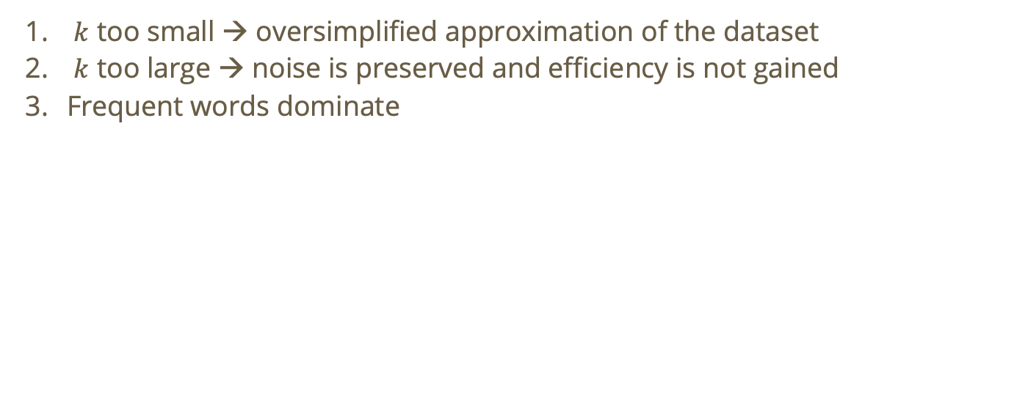
What causes bad embeddings?
$k$ too small → oversimplified approximation of the dataset
$k$ too large → noise is preserved and efficiency is not gained
Frequent words dominate
We can use the elbow method by plotting singular values in descending order and finding the point of diminishing returns

Slide 35
What causes bad embeddings?
$k$ too small → oversimplified approximation of the dataset
$k$ too large → noise is preserved and efficiency is not gained
Frequent words dominate
Why is this a problem?

Slide 36
Do not edit
How to change the design
Why is the word 'the' problematic for plain term-frequency-based LSA?
The Slido app must be installed on every computer you’re presenting from

Slide 37
Term Frequency in LSA
Take these example “documents”:
”the dog plays in the park”
“the cat sleeps in the house”
”the government passed a law”
Here, “the” appears in every document but it carried no semantic meaning…
This means in our term-document matrix, “The” will have the highest frequency and as a result, SVD will detect that it contributes the most variance.

Slide 38
Term Frequency in LSA
Take these example “documents”:
”the dog plays in the park”
“the cat sleeps in the house”
”the government passed a law”
We see a clear semantic structure here. One “latent feature” could be pets, another could be politics.
Because “the” contributes the highest variance, LSA might capture the latent features as documents which contribute many ”the” versus documents which contribute fewer “the” which is semantically useless!

Slide 39
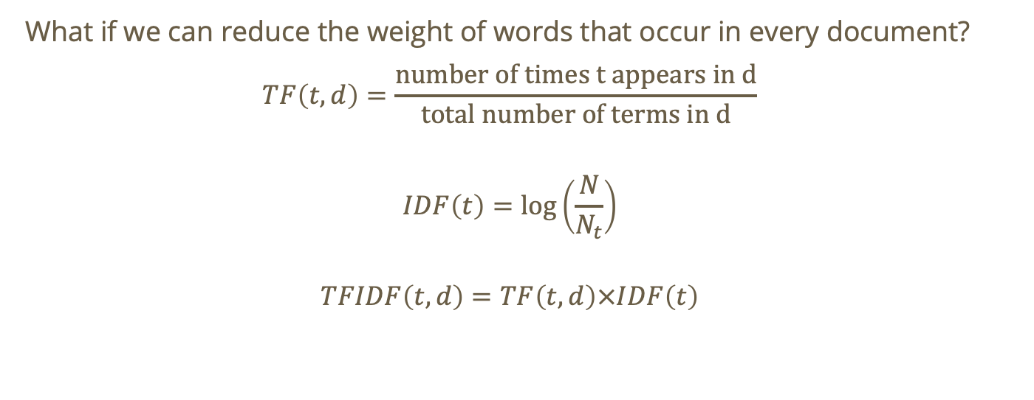
Question: How do we handle frequent “useless” words?
What if we can reduce the weight of words that occur in every document?
$$TF\left(t,d\right)=\frac{\text{number of times t appears in d}}{\text{total number of terms in d}}$$
$$IDF\left(t\right)=\log\left(\frac{N}{N_{t}}\right)$$
$$TFIDF\left(t,d\right)=TF\left(t,d\right)×IDF\left(t\right)$$
Notes:
Note: with idf rarer words get higher weight

Slide 40
Do not edit
How to change the design
What is the role of TF-IDF?
The Slido app must be installed on every computer you’re presenting from

Slide 41
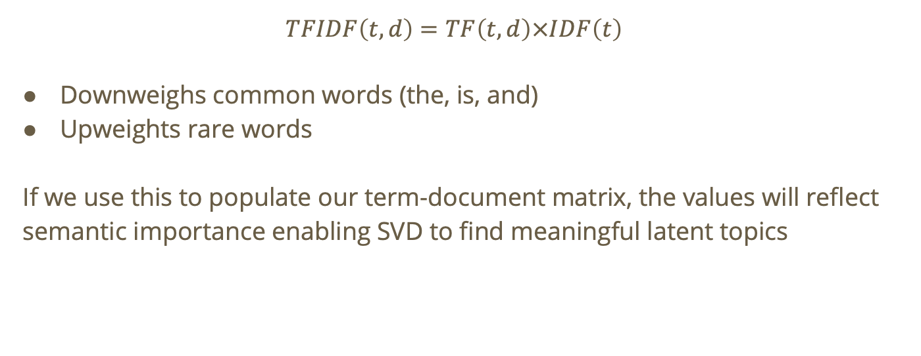
TF-IDF
$$TFIDF\left(t,d\right)=TF\left(t,d\right)×IDF\left(t\right)$$
Downweighs common words (the, is, and)
Upweights rare words
If we use this to populate our term-document matrix, the values will reflect semantic importance enabling SVD to find meaningful latent topics
Notes:
Read as “term frequency of word t in document d” times “inverse document frequency of term t”

Slide 42
TF-IDF for term-document matrix
If we apply TF-IDF to find our term-document matrix before running SVD, we will be able to ignore some of the noise in our dataset.
The reality is that most documents will contain conjunctions and linking verbs, many of which we don’t want to include! TF-IDF helps us work around that

Slide 43
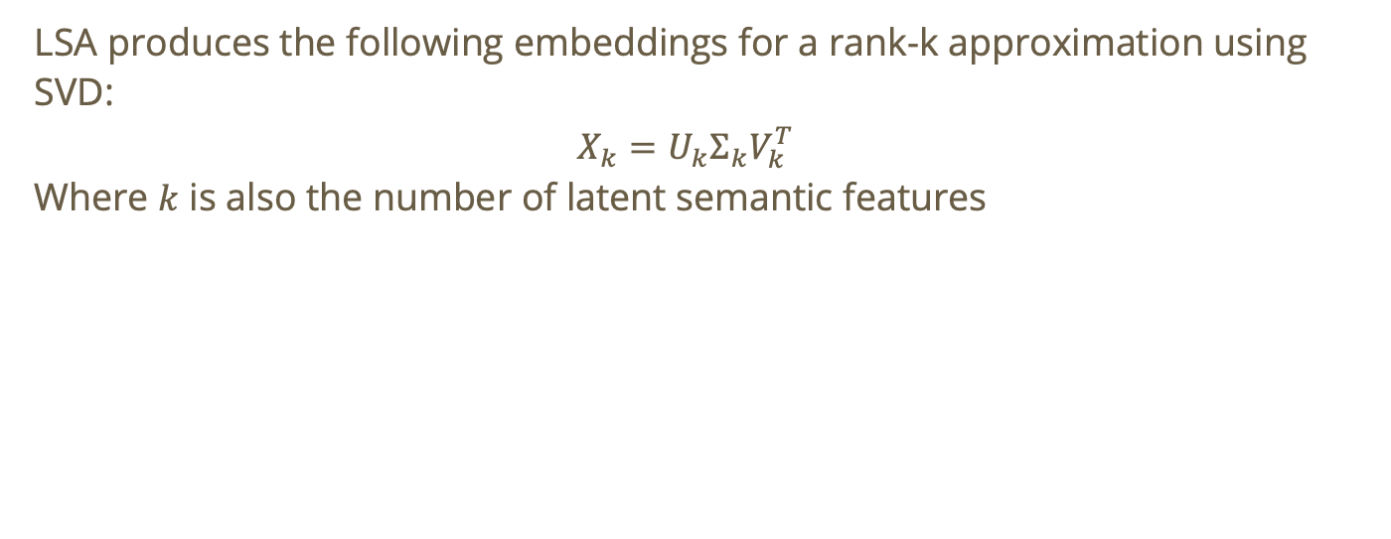
Interpreting results of LSA
LSA produces the following embeddings for a rank-k approximation using SVD:
$$X_{k}=U_{k}Σ_{k}V_{k}^{T}$$
Where $k$ is also the number of latent semantic features

Slide 44
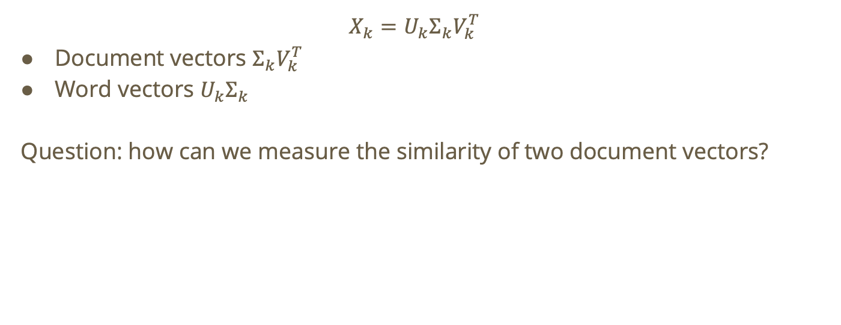
Interpreting results of LSA
$$X_{k}=U_{k}Σ_{k}V_{k}^{T}$$
Document vectors $Σ_{k}V_{k}^{T}$
Word vectors $U_{k}Σ_{k}$
Question: how can we measure the similarity of two document vectors?

Slide 45

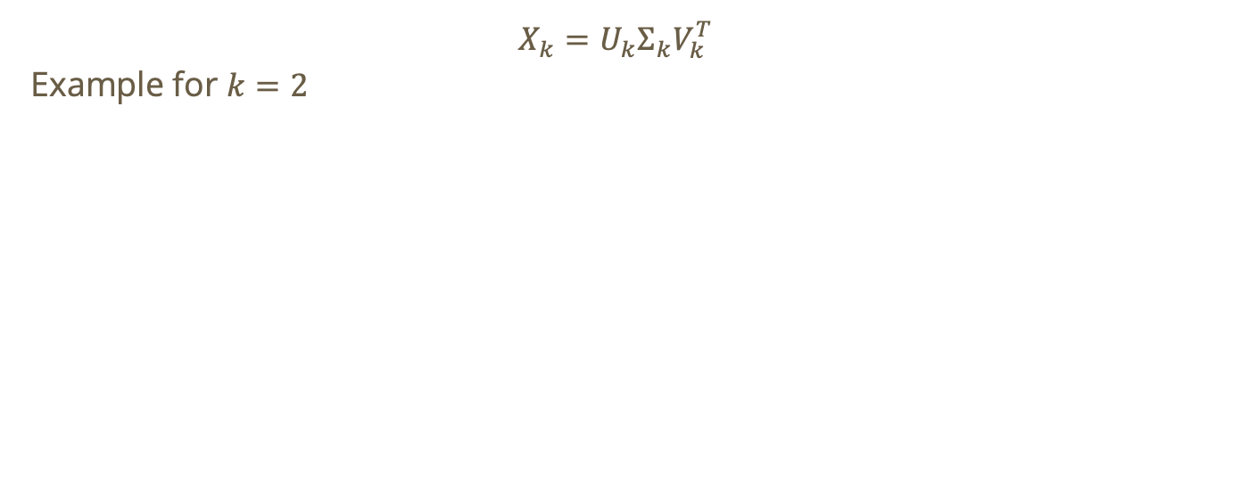



Interpreting results of LSA: Cosine Similarity
$$X_{k}=U_{k}Σ_{k}V_{k}^{T}$$
Example for $k=2$
$$p_{1}$$
Medical
Cosine similarity will correspond to semantic similarity! → Each document exists in our latent semantic space and similar documents are close to one another!
$$p_{2}$$
$$p_{3}$$
$$p_{4}$$
Computer Science

